Slide 1




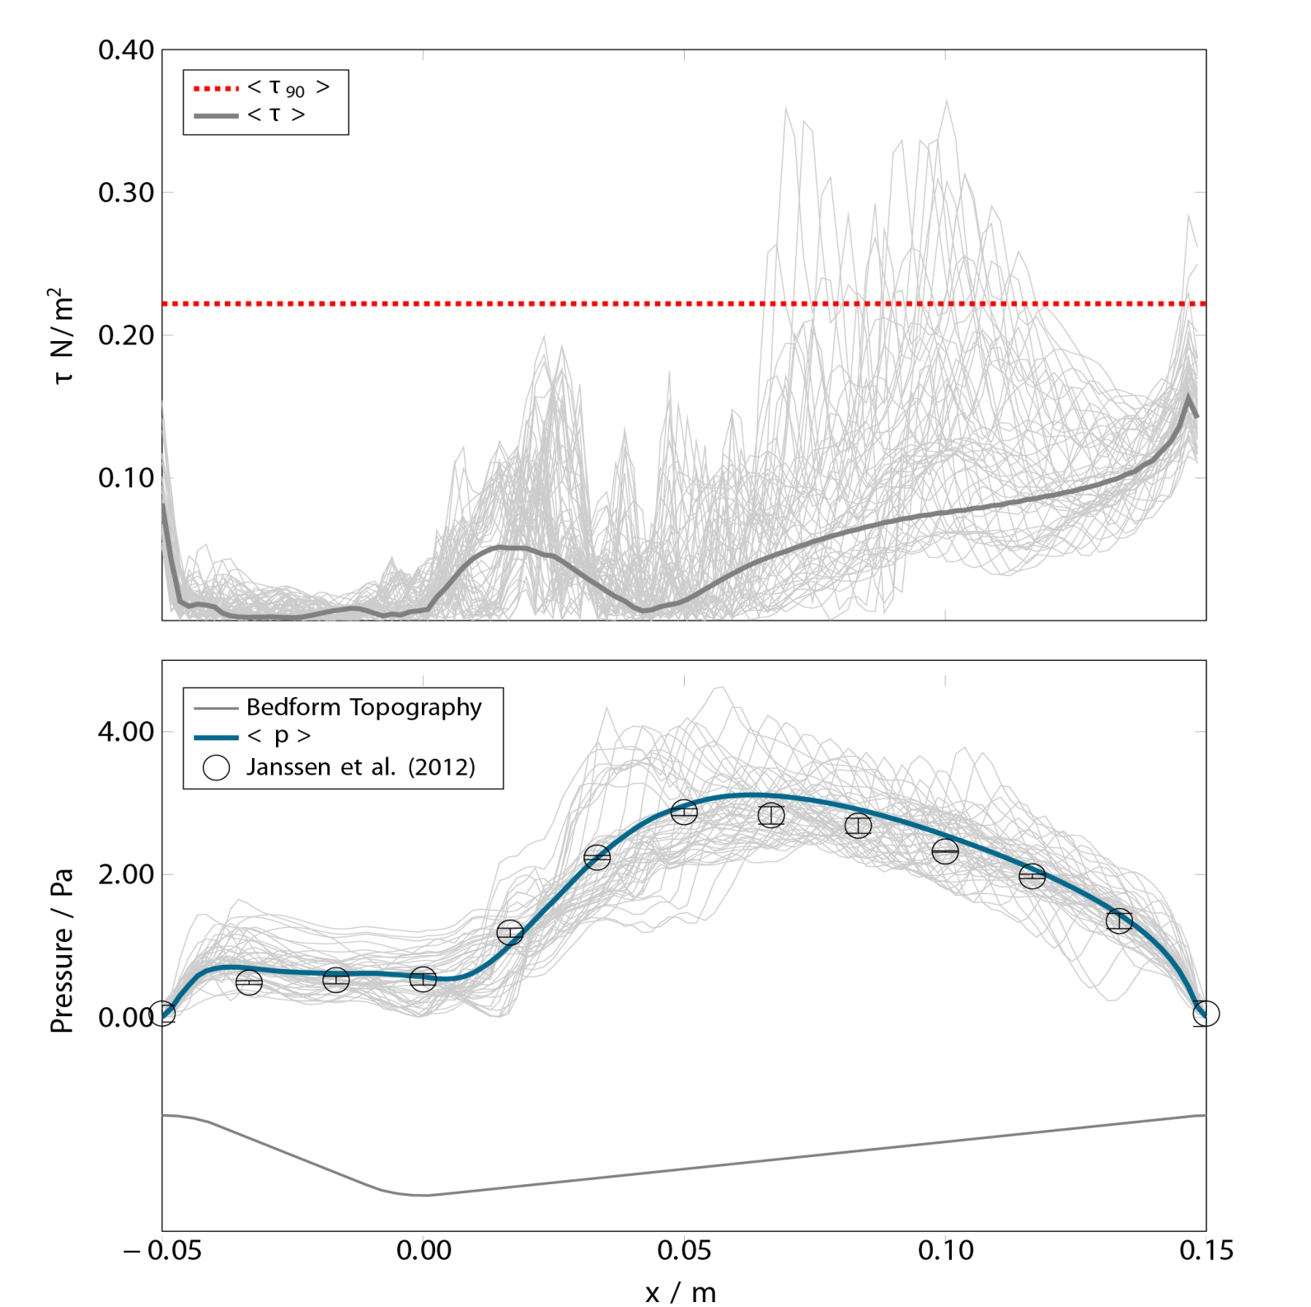
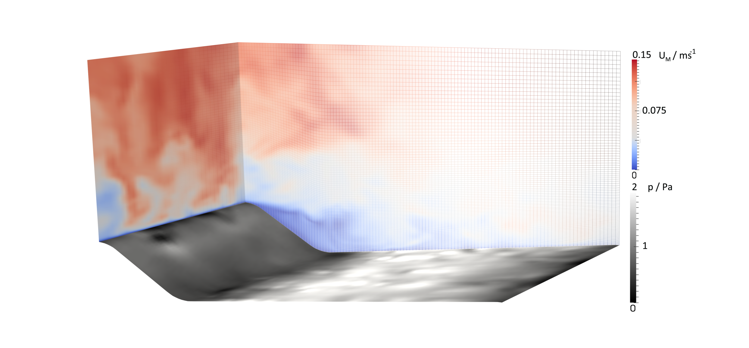
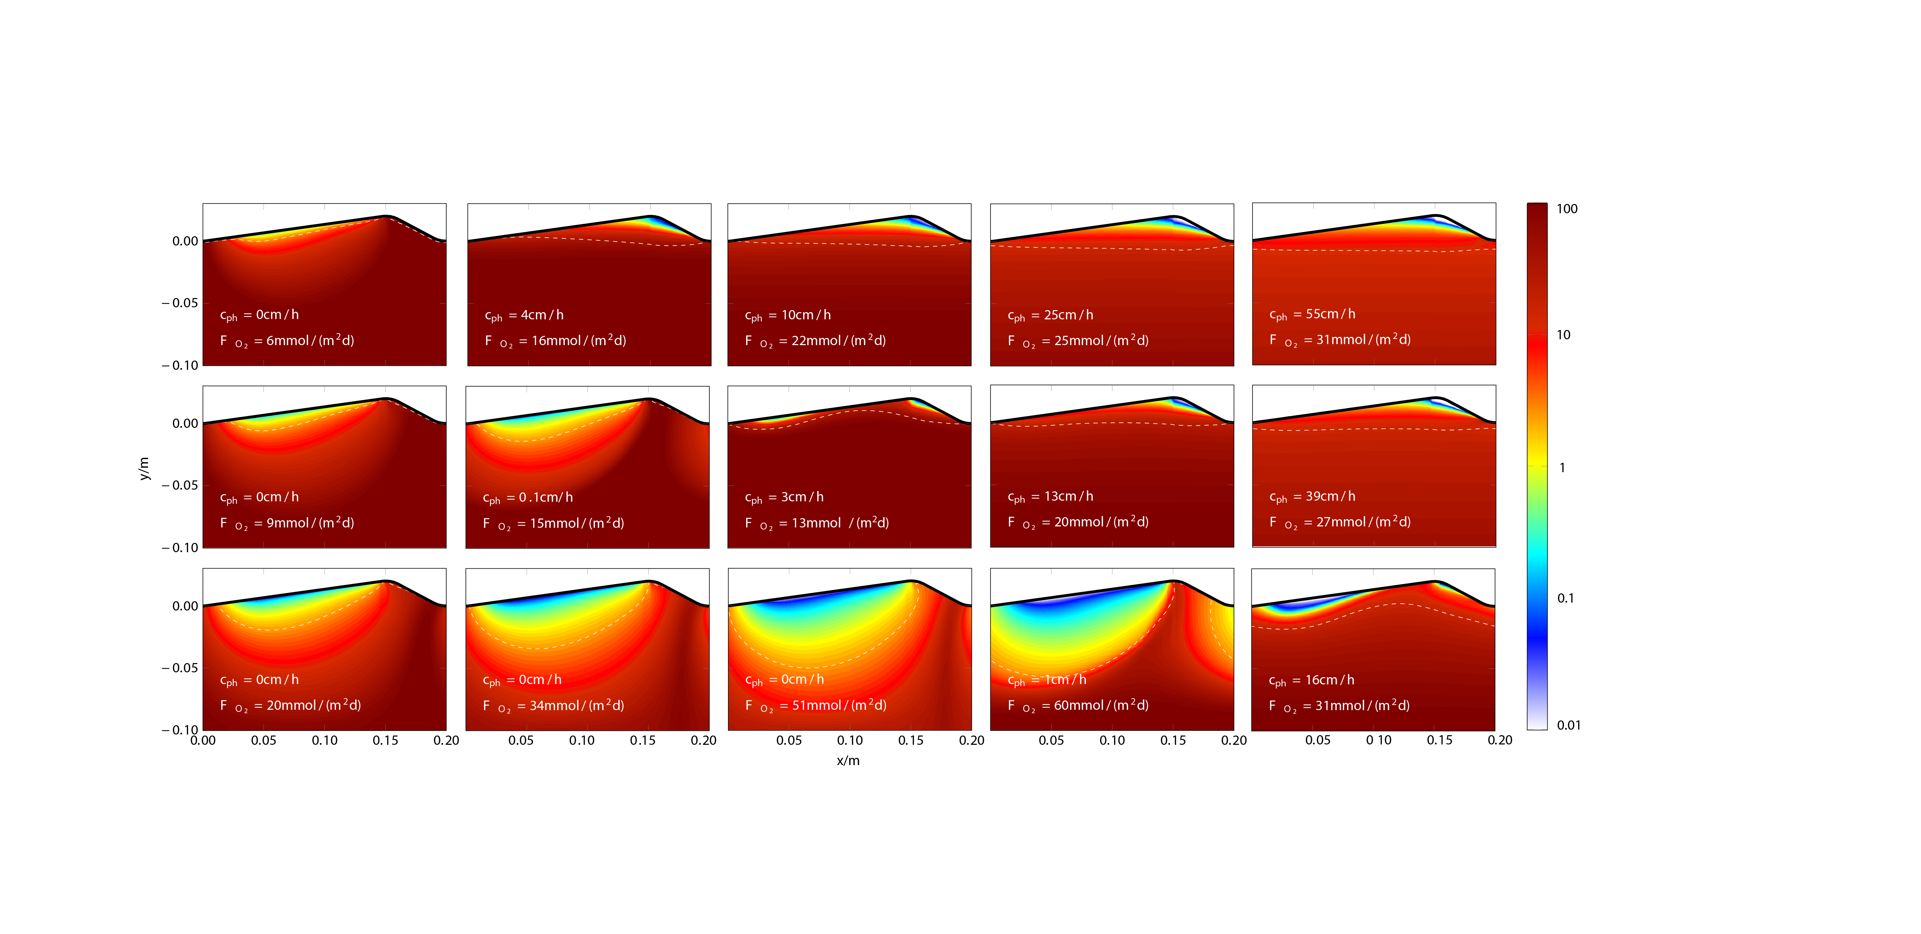

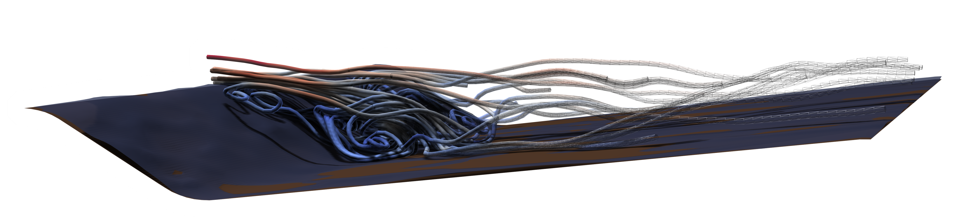

The Interaction of Migrating Bedforms and Pressure-Driven Advective Porewater Flow
S. Ahmerkamp¹, C.Winter², F. Janssen³, D. de Beer¹, M.M.M Kuypers¹ and M. Holtappels¹
¹Max Planck Institute for Marine Microbiology, Bremen, Germany
²Marum – Center for Marine Environmental Sciences, University of Bremen, Germany
³Marum HGF-MPG Group for Deep Sea Ecology and Technology / Alfred Wegener Institute, Bremerhaven, Germany
I N T R O D U C T I O N
M E T H O D S
The flow of bottom water across rippled topographies is an important driver of porewater flow in permeable shelf sediments and is well studied using laboratory flumes and mathematical models. However, most of these studies assume a fixed topography and do not consider the dynamic redistribution of sediment. Ripple formation and migration introduce other modes of porewater exchange that have been neglected so far.
SIMULATION
b1
Bed Shear Stress
EMPIRICAL
TRANSPORT MODEL
Input:
Bottom Water Velocity (U)
Bedform Topography
Input: Grain Size
a
Celerity (cph) Coleman & Melville 1994
Permeability Gangi 1985
Large Eddy Simulation
b2
Pressure
Bed Load
Transport
Coordinate
Transformation
Darcy
y
y
y
x
Time Averaged
c
Input: Reaction Kinetic (Oxygen)
REACTION MODEL
x
x‘=x+cph
b1
?
Calculate Oxygen distribution in porous media for migrating bedforms
How does the migration of bedforms interact with pressure-driven porewater flow?
What are the consequences for biogeochemical processes?
a
b2
To study these interactions we applied a multi-physics model coupling the transport in bottom water (Large-Eddy-Simulation, Fig. 1+2) and porous media (Darcy) with rates of oxygen respiration. Ripple migration (celerity) was implemented using additional transport terms in the porous domain.
y
z
Fig. 2: Simulation of the flow field was accurate as indicated by the high agreement of measured and simulated pressure distribution (lower panel). The bed shear stress (upper panel) was extracted and implemented in the empirical relation of the ripple migration. The light gray lines indicate the instantenous values.
x
Fig. 1: Snapshot of the instantenous flow field and pressure distribution along the bedform. The grid consists of Nx = 120, Ny = 100, Nz = 50 nodes. For all simulations OpenFOAM® v. 2.2.2 was used.
R E S U L T S
a
For 15 cases, the combined effect of bottom water velocity and sediment grain size on ripple migration, porewater transport, and O2 distribution was modeled (Fig. 3) and can be summarized as follows:
U0 = 11cm/s
Re = 1500
U1 = 18cm/s
Re = 2400
U2 = 22cm/s
Re = 3000
U3 = 30cm/s
Re = 4000
U4 = 40cm/s
Re = 5400
c
3
Increasing Grain Size,
increases the permeability and increases the O2 flux
increases the critical bed shear and decreases the ripple migration
d = 174 μm
d = 265 μm
2
Waterage /h
Effects for increasing Bottom Water Velocity:
Oxygen uptake increases until migration starts
With increasing ripple migration, pressure-driven porewater flow in deeper layers ceases, and water penetrates from both sides of the ripple
When migration dominates, the bedforms are fully flushed, the deeper layer is separated and diffusion limited
d = 405 μm
1
Fig. 3: The stationary distribution of porewater age (pseudocolor, in hours) and the O2 penetration depth (dashed lines) are shown for a range of realistic bottom water velocities and grain sizes as found in the North Sea . Settings: ripple height: 2 cm; Reaction: 100 µM/h and km:35µM; permeability: 10⁻¹⁰m² – 10⁻¹¹ m²
D I S C U S S I O N
Three modes of porewater flow were identified in the modeling study (Fig. 3+4) :
3
When the ripple migration becomes more pronounced, O2 uptake from the lee side dominantes and the O2 fluxes increase until the ripple is fully flushed. The O2 distribution becomes quasi 1-dimensional and mainly vertical O2 gradients are found in the sediment.
1
At low velocities, when the topography is fixed, oxygen transport and fluxes depend only on pressure driven porewater flow. The O2 distribution is highly 2-dimensional. Both, vertical and horizontal O2 gradients are found in the sediment.
When the bed shear stress approaches the critical threshold, ripples start to migrate. With increasing ripple migration the pressure gradients in deeper layers change too fast to allow effective porewater flow and diffusive transport starts dominating. As a result the O2 fluxes decrease, especially for coarse grained sediments where high permeability caused a deep O2 penetration at steady state.
2
O2 Flux
2
3
1
Depends on
Grain Size
Cph > 0
Bottom water velocity
Correspondence: sahmerka@mpi-bremen.de
http://www.mpi-bremen.de/Soeren_Ahmerkamp
References:
Coleman & Melville (1994): Bed-Form Development. J. Hydr. Eng., 120 (4)
Gangi (1985): Permeability of unconsolidated sands and porous packs. J. Geophys. Res., 19 (B4): 3099-3104.
Janssen et al. (2012): A comparative experimental and multiphysics computational fluid dynamics study of coupled surface–subsurface flow in bed forms. Water Resour. Res. 48 doi:10.1029/2012WR011982
Fig. 4: Schematic illustration showing the effect of bedform migration on the O2 flux.
Acknowledgements:
This project was funded by the Max Planck Society and Deutsche Forschungsgemeinschaft (through the Marum Center for Marine Environmental Sciences).

